Slide 1

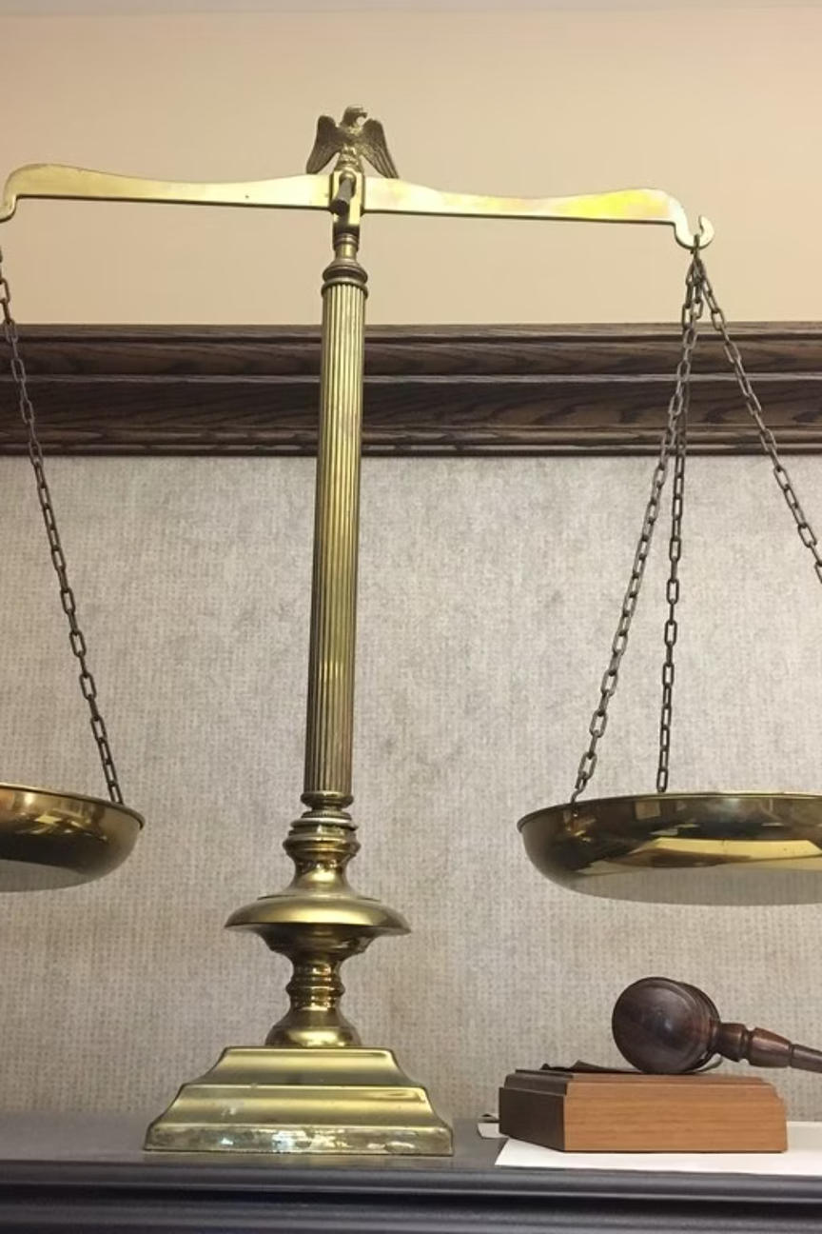
The COMPAS Recidivism Algorithm
An examination of ethics, bias, and accountability in AI-driven criminal justice systems
Notes:
1

Slide 2

The Algorithmic Justice Revolution
The Shift
The Promise
AI and machine learning have fundamentally changed high-stakes decision-making in criminal justice, employment, healthcare, and access to opportunities.
Algorithmic systems are praised as objective tools capable of reducing human bias and bringing consistency to complex decisions.
Yet this shift introduces serious ethical concerns. When AI systems are trained on historical data shaped by social inequalities, they absorb, optimize, and reproduce those inequalities. What appears to be neutral mathematical objectivity can mask deeply embedded structural bias.
Notes:
2

Slide 3




What is COMPAS?
Proprietary Tool
137 Questions
Developed by Northpointe, Inc. (now Equivant), widely adopted by courts and correctional agencies across the United States.
Defendants complete extensive survey about socio-economic background, family history, peer behavior, and personal circumstances.
Risk Scores
Generates numerical scores (1-10) classifying individuals as low, medium, or high risk for general and violent recidivism.
Notes:
3

Slide 4

The ProPublica Investigation
May 2016 - Analysis of 7,000+ Defendants
ProPublica's investigation of Broward County, Florida data revealed troubling racial disparities in error rates, challenging assumptions of algorithmic neutrality.
61%
20%
General Recidivism Accuracy
Violent Recidivism Accuracy
Only slightly better than chance
Significantly lower prediction rate
Notes:
4

Slide 5




Racial Disparities in Error Rates
44.9%
23.5%
False Positive Rate - Black
False Positive Rate - White
Black defendants who did not reoffend incorrectly labeled high risk
White defendants who did not reoffend incorrectly labeled high risk
47.7%
28.0%
False Negative Rate - White
False Negative Rate - Black
White defendants who reoffended incorrectly classified as low risk
Black defendants who reoffended incorrectly classified as low risk
These disparities remained significant even after controlling for prior criminal history, age, gender, and actual reoffending rates.
Notes:
5

Slide 6


Key Academic Findings
Dressel & Farid (2018)
Non-expert humans using only 7 basic features achieved 67% accuracy—matching COMPAS's 65.2% with 137 variables. A simple 2-variable model performed identically to proprietary system.
Selbst et al. (2019)
Identified five abstraction traps: Framing, Portability, Formalism, Ripple Effect, and Solutionism. Fairness is not a property of software but of entire social systems.
Slack et al. (2020)
Demonstrated that explanation tools like LIME and SHAP can be manipulated. Adversarial techniques fooled explanations in every tested case, concealing discriminatory logic.
Notes:
6

Slide 7







Seven Pillars of AI Ethics
Evaluation of COMPAS Through Ethical Framework
Fairness
Accountability
Transparency
Unequal error rates disproportionately harmed Black defendants. System absorbed historical disparities from biased policing data.
Responsibility diffused between vendor, data, and judge. No party could be directly held accountable for score calculation.
Proprietary calculations protected as trade secrets. Defendants cannot meaningfully question logic behind risk scores.
Privacy
Safety
Explainability
137-question survey in coercive booking environment raises questions about genuine informed consent.
Inflated scores led to longer detention, higher bail, extended sentences with serious life consequences.
Numerical scores provided without clear explanation of contributing factors or reasoning paths.
Responsibility
Limited ability to challenge algorithmic formula itself, narrowing scope of contestation and redress.
Notes:
7

Slide 8





Explainable AI: Promise and Limits
The Black Box Problem
Post-Hoc Explanations
COMPAS opacity was not technical necessity but legal protection under trade secrets. Relatively standard statistical techniques shielded from scrutiny.
Tools like LIME and SHAP provide local interpretability but can be manipulated through adversarial techniques to conceal discriminatory logic.
Problem
Opaque proprietary systems
Proposed Solution
Post-hoc explanation tools
Reality
Vulnerable to manipulation
True Fix
Interpretable glass-box models
Notes:
8

Slide 9
Essential Safeguards and Solutions
01
02
03
Mandatory Glass-Box Models
Independent Audits
Right to Contestation
Rigorous third-party evaluation before deployment and periodic audits examining racial disparities and proxy variables.
Access to meaningful explanations, ability to question computational logic, guaranteed human review rights.
Inherently interpretable systems transparent by design, open to adversarial scrutiny and plain-language explanation.
04
05
Data Governance
Accountability Frameworks
Bias impact assessments, careful evaluation of proxy variables, transparent documentation through Model Cards.
Shared responsibility between developers and institutions, clear documentation of human overrides, discouragement of blind reliance.
Notes:
9

Slide 10
Key Takeaways
Algorithmic Neutrality is a Myth
Transparency is Non-Negotiable
AI trained on historical human data reflects embedded inequalities. Complexity does not automatically produce fairness or accuracy.
Post-hoc explanations are insufficient in high-stakes settings. Glass-box models must be legally mandated prerequisites.
Accountability Requires Power
Explanations alone don't guarantee accountability. Decision-makers need authority, knowledge, and support to meaningfully challenge algorithms.
AI in criminal justice cannot rely on proprietary algorithms. Transparency and interpretability must be legally mandated prerequisites rather than optional features.
Notes:
10

